Slide 1
DLI Parent Meeting
May 14, 2024

Slide 2
Meeting Agenda
Program Overview
ELA in first grade
Curriculum and assessment
Preparing for 1st Grade
Notes:
Zhao

Slide 3
Understanding Our DLI program
We are a Dual Language Teaching program
English
Chinese
Teach the Common Core Standards
Notes:
Zhao:First of all please Allow me to provide a brief overview of our 1st-grade DLI program's structure and objectives.
Our DLI program is designed with a focus on utilizing Mandarin not just as a language course but as the primary instructional language for delivering Common Core Standards. This approach ensures that students are immersed in Mandarin, benefiting from increased exposure to the language, particularly for those Mandarin is a second language.
It is essential to note that our DLI program caters not only to Mandarin-dominant families but to a diverse range of students seeking to enhance their language proficiency. To delve deeper into the specifics of our program, I would like to introduce Ms. Kang to elaborate further.

Slide 4
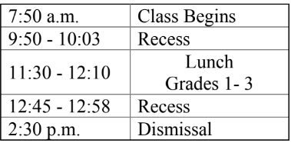
Transition to full day
Notes:
zhao

Slide 5
Social Studies/Science
(Mandarin)
Math
(Mandarin)
Mandarin Language Art
English Language Art
Notes:
zhao:In the 1st-grade Dual Language Immersion (DLI) program, students engage with a comprehensive curriculum encompassing four key subject areas. These subjects are carefully integrated to provide a holistic and enriching learning experience for our young learners. Let's explore the four components that form the foundation of our 1st-grade DLI curriculum:
Language Arts:
Reading and writing activities that develop literacy skills in both English and Mandarin.
Mathematics:
Mathematical concepts and problem-solving techniques taught in Mandarin to strengthen numeracy skills.
Science:
Hands-on experiments and exploration of scientific concepts in mandarin to foster a curiosity for the world around them.
Social Studies:
Learning about history, geography, and social issues in mandarin setting to promote a global perspective and cultural understanding.
By incorporating these four essential subjects into our DLI curriculum, we aim to provide students with a well-rounded education that nurtures their language proficiency, critical thinking abilities, and appreciation for diverse cultures.

Slide 6


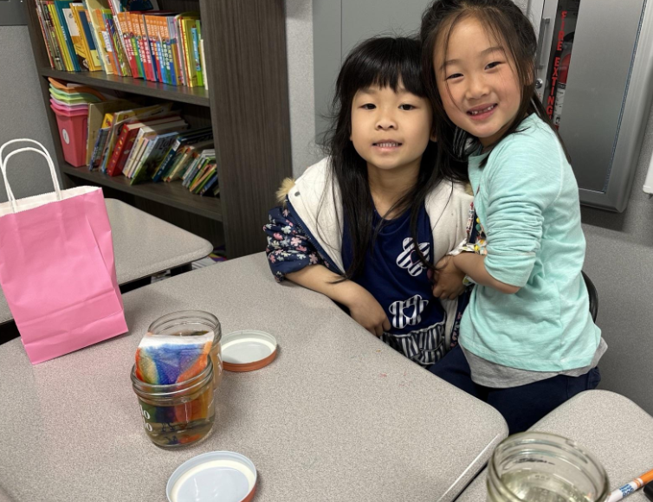
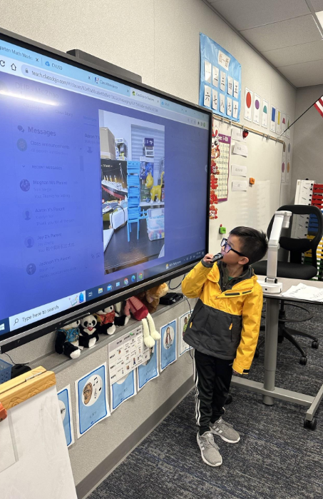
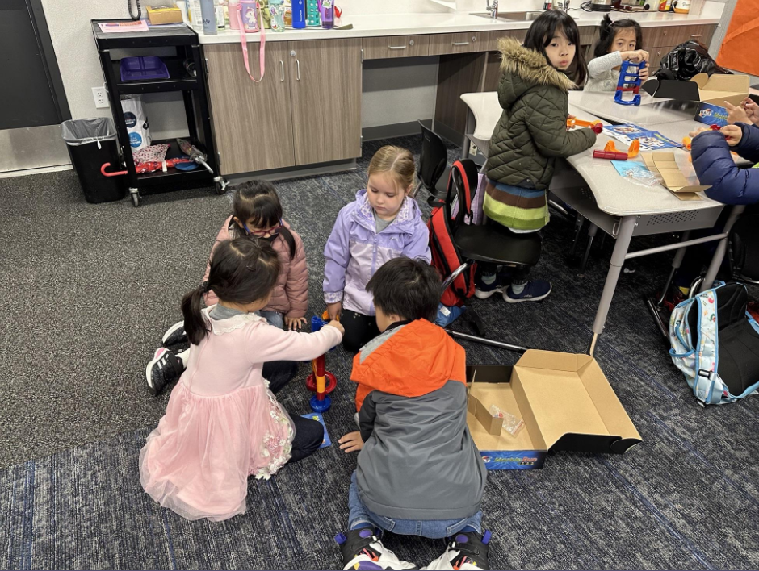
MLA Integrated with Social Study & Science
Notes:
zhao: During the Social study and science time block, we are going to connect student’s language skills and embed it in their STEM related field. As you can see from our MLA curriculum there are some topics where it overlaps with the other subjects. The MLA Curriculum has provided the language that is needed in other subjects. In our social studies and science instruction, it will be project based and provide hands down activities opportunities. Our goals is to guide students to apply their learning of academic language in their speaking, enrich their knowledge of academic vocabulary.
To delve deeper into the specifics of our program, I would like to introduce Ms. Kang to elaborate her English portion.

Slide 7



How to Prepare for 1st Grade (ELA)
Review Uppercase & Lowercase letter writing and letter sounds.
Review & practice Pre-Primer & Primer High Frequency Words.
Routine visits to the library (read, read, read!)
Try to keep a journal (combination of drawing & writing)
Notes:
kang

Slide 8


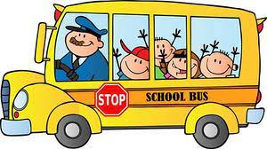
What to Expect - ELA
ELA 10% = 45 minute instructions daily
District Curriculum - Wonders (McGraw-Hill)
iReady Reading practice & Assessment
STAR Assessment (reading/comprehension)
Essential Standards based class work & projects
1st grade HFW (high frequency words)
Reading fluency practices (guided reading) & shared reading
Introduce a wide range of fiction & nonfiction books
Writing Practices & shared writing
English intervention available upon need
Notes:
Kang

Slide 9
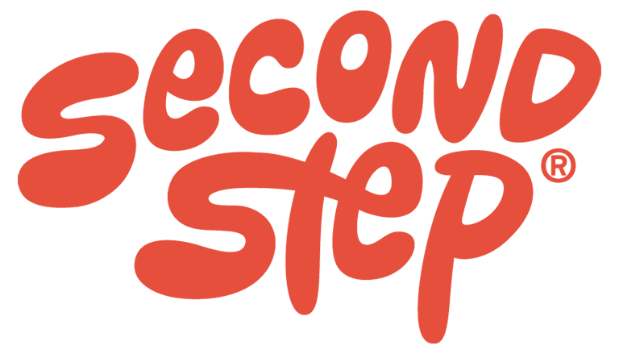
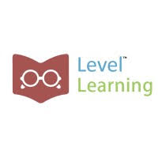
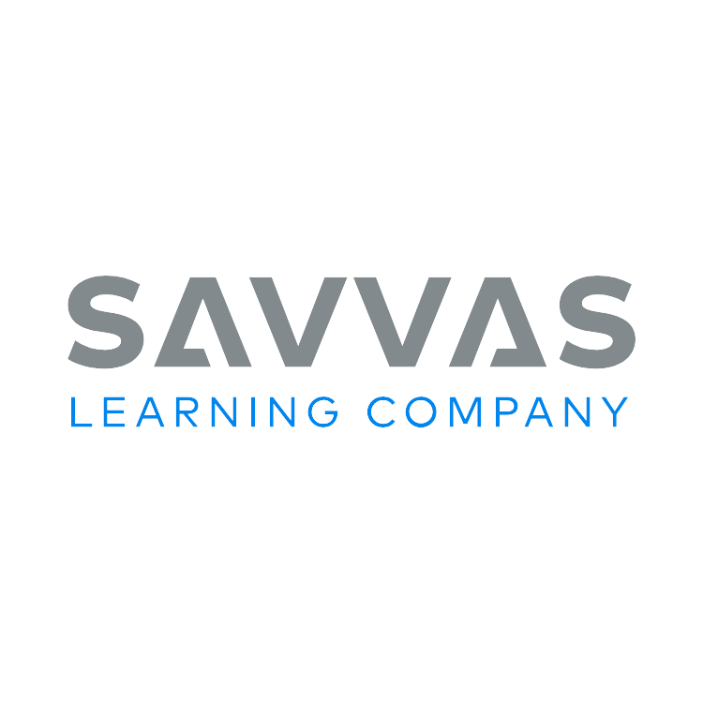
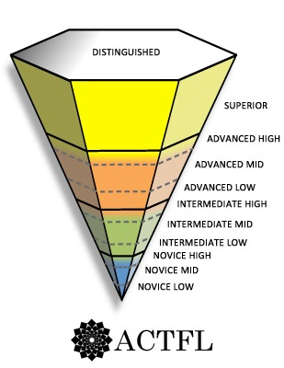
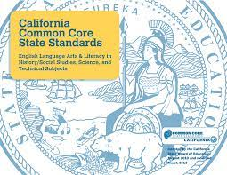
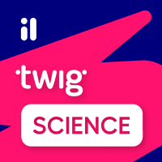


Mandarin Immersion Curriculum Design
Based on Common Core Language Art Standards- Reading and Writing
Based on ACTFL (American Console on Teaching Foreign Language Standards Proficiency Guideline)
California Common Core Math Standards - Savvas
History–Social Science for California Public Schools
California Next Generation Science Standards(NGSS)
  Twig
Level Learning Program
Youth Chinese Test- Vocabulary and Grammar Points
SEL - Second Step Learning
Notes:
Chen: This is the overview of what is our curriculum based on and provide the reason of why our curriculum based on these standards. First, our MLA curriculum is based on CCCS of reading and writing and ACTFL so that our students’ language development is following the California Education Standards just like other students. As for math, we are going to based on the Savvas curriculum which is also align the CCCS. Twig is the curriculum that we will be using for science. For subjects of social studies and science, the curriculum are also align with the California social sciences standards and the NGSS. The alignment with California Education Standards ensures that our students acquire the necessary skills and knowledge to succeed academically and meet state requirements for learning outcomes.

Slide 10
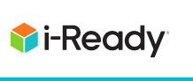
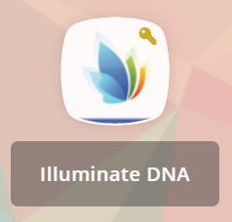
Program standard based Assessment
Mandarin
Math
Notes:
Bai: We will continue use Level learning as our main way to assess students language proficiency in Mandarin. We will also use i-Ready diagnostic and ESA in assessing student’s growth in ELA and Math.

Slide 11
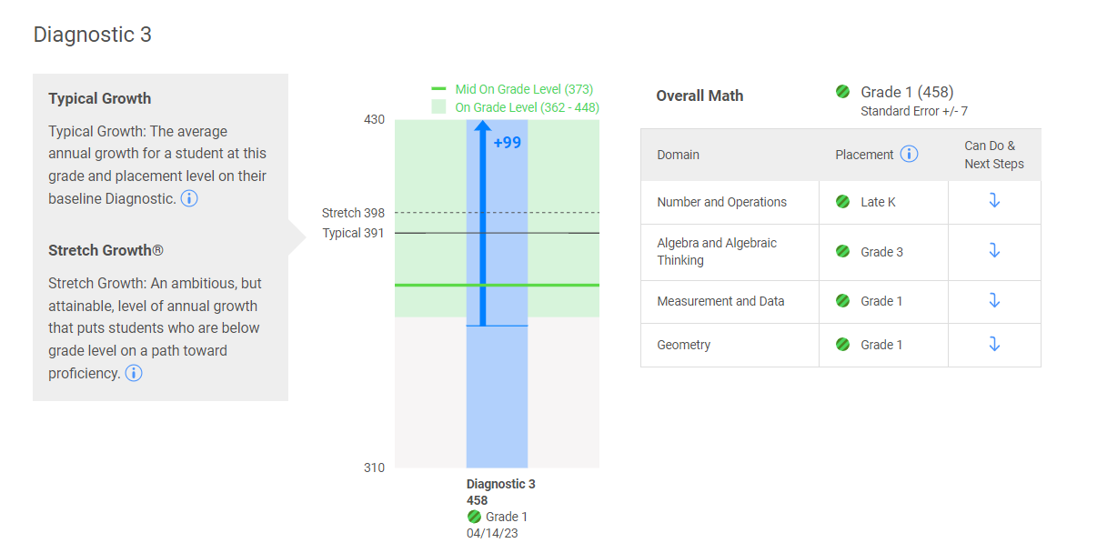
How to understand i-Ready Math Grade
Notes:
Bai: Here is a example of the i-Ready diagnostic graphic. In math, it will break into four domains, numbers and operation, algebra and algebraic thinking, measurement and data and geometry. The blue graphic will reflect student’s growth from previous assessment to current assessment. i-Ready diagnostic is a progressive assessment, so it will get harder base on student’s capability.

Slide 12


(Mandarin)Level Learning Reading Diagnostic
Reading Comprehension
Progressive Assessment
Language and Vocabulary
Notes:
Chen: As Ms. Bai mentioned earlier, we will use level learning as our Mandarin assessment. The levels and standards of Level Learning were developed based on the Common Core ELA Anchor Standards. The initial test level for Level Learning starts at level C. As students develop their reading skills, the reading levels will progress in alphabetical order. Each level of test, it consists of two components: R for reading comprehension and L for Language and Vocabulary.

Slide 13
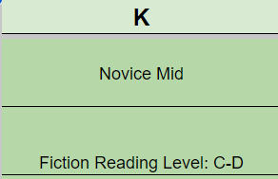
Kindergarten MLA Benchmark
K Grade End of School Year Benchmark
Fiction Reading Level C-D
Oracy: Novice Mid
Notes:
Chen: Here is a quick look that the Kindergarten benchmark. As you can see, at the end of the school year, Kindergarteners’ benchmark is fiction reading will be level C to D from level learning, and the oral language proficiency will be expected to be in Novice Mid novice mid. and also Expected reading level which Level C-D.

Slide 14
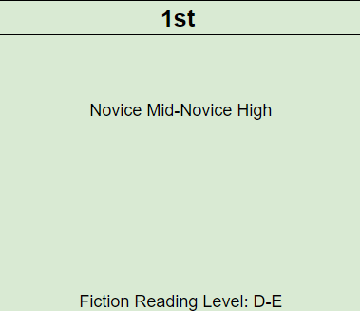
1st Grade MLA Benchmark
1st Grade End of School Year Benchmark
Fiction Reading Level D- E
Oracy: Novice Mid-Novice High
Notes:
Chen: So for 1st grade, our end of school year benchmark in reading will be in level D to E and oracy will be expected in novice mid and novice high.

Slide 15
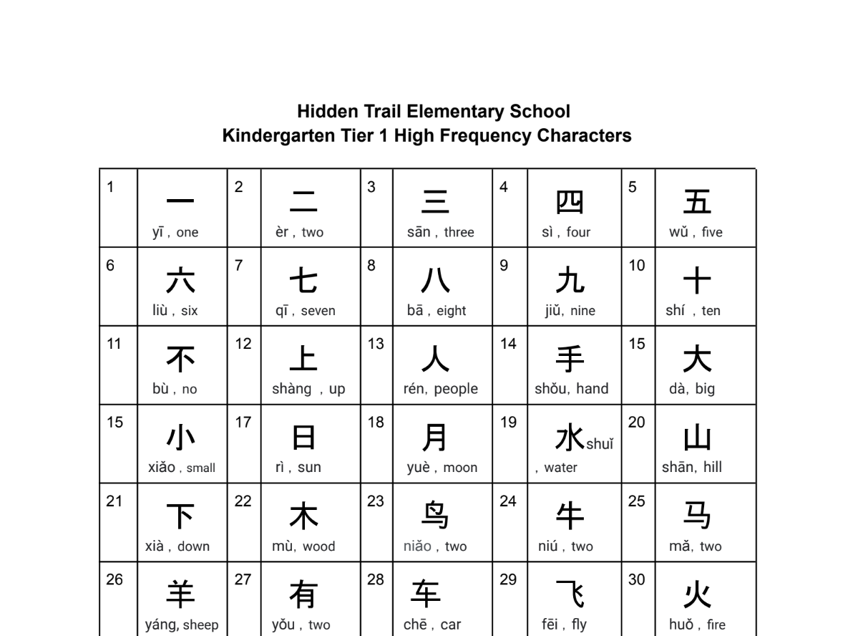
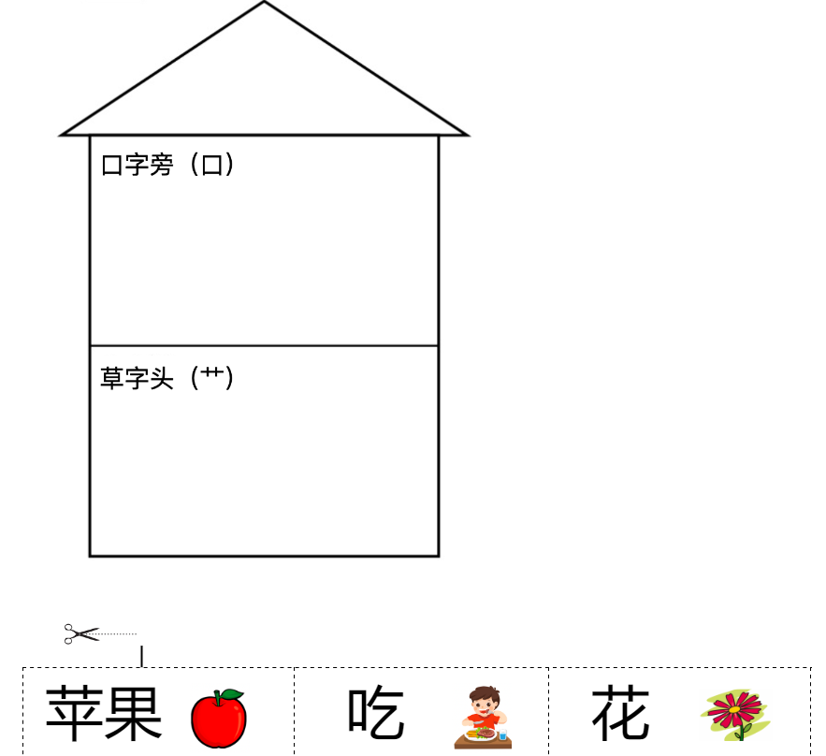
Preparing for 1st Grade in Summer
1st Grade MLA is based on vocabulary and reading skills learned in K
  Recognize all Tier 1 and Tier 2 Characters
  Be able to dictate Tier 1 HFW
  Familiar with radicals introduced in K
Encourage to reading Mandarin book at least with level C
Mandarin Checklist
Notes:
Bai

Slide 16


Thank You
Notes:
Thanks everybody for attending our meeting today . we will provide more workshop to support students both in family and school in the new school year. We hope you all have a great and safe summer.

